Slide 1
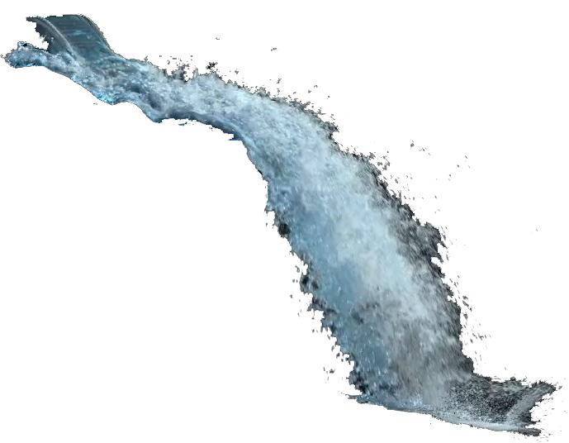
An Exploration of Optimisation Techniques for Particle Systems in Vulkan
Robin Wragg
Image: Yoshida, 2012

Slide 2
An Exploration of Optimisation Techniques for Particle Systems in Vulkan

Slide 3
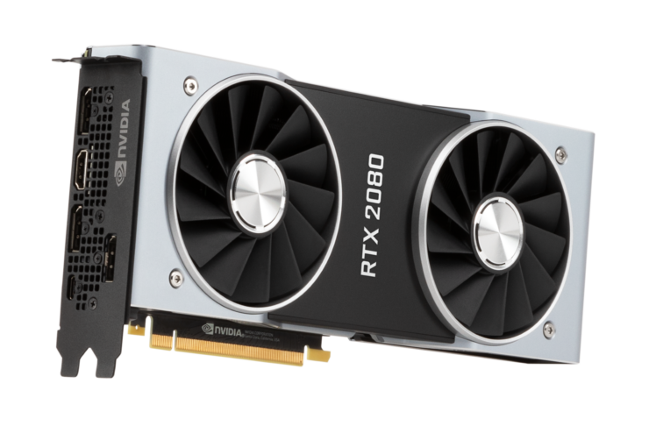

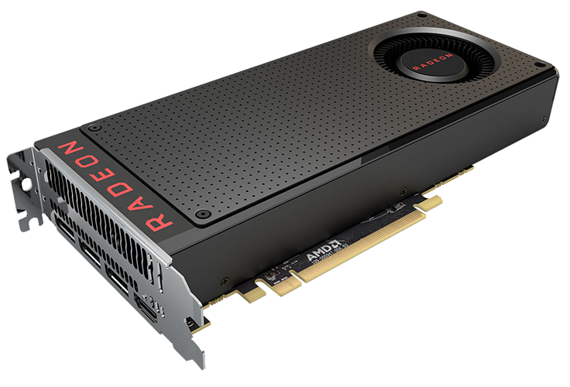

An Exploration of Optimisation Techniques for Particle Systems in Vulkan
?

Slide 4




An Exploration of Optimisation Techniques for Particle Systems in Vulkan

Slide 5
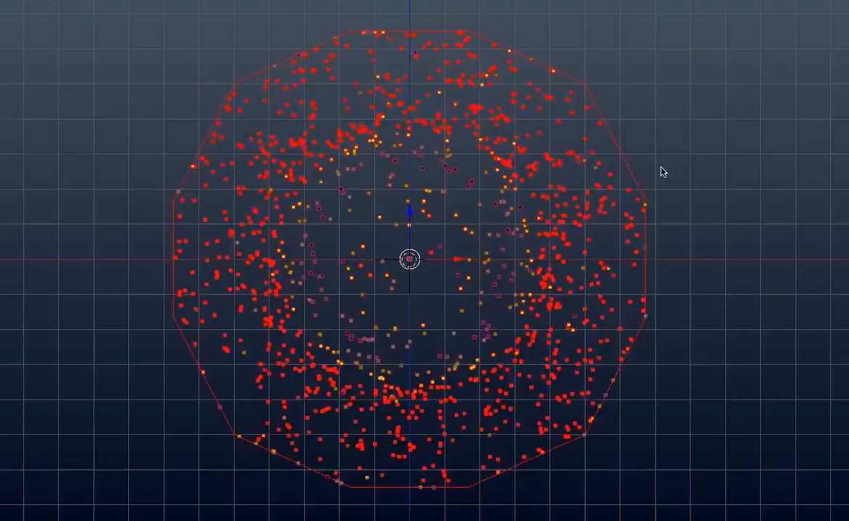
Iridesium, 2008

Slide 6
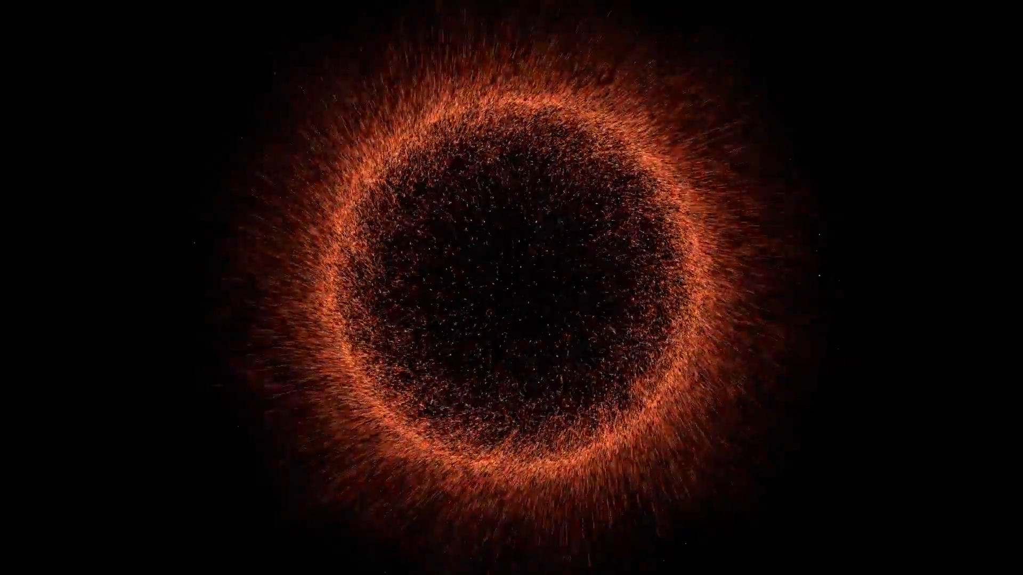
Iridesium, 2008

